Slide 1
Does climate change exist?
Christian
David
Allison

Slide 2
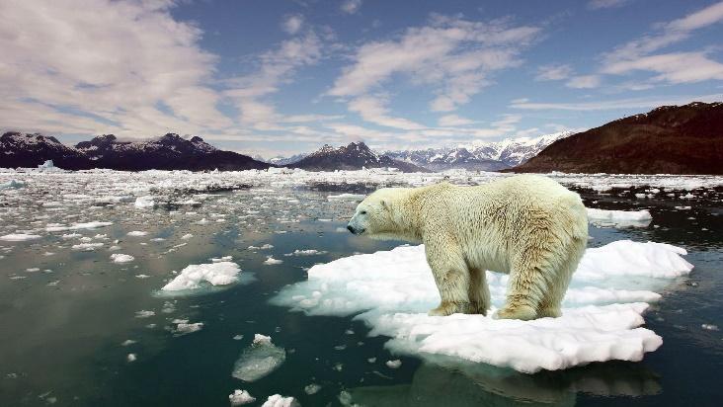
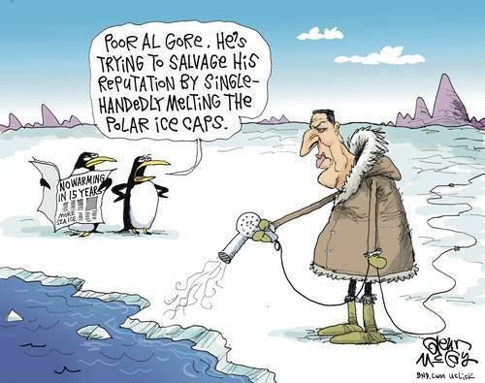
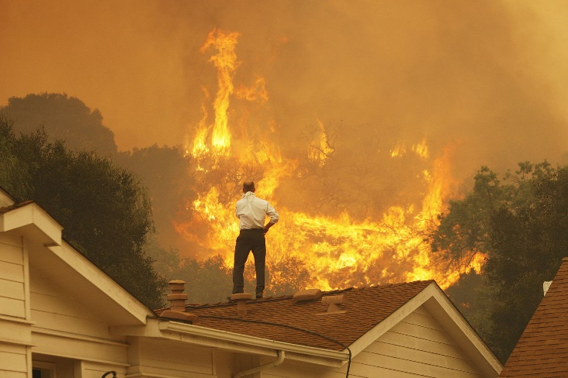
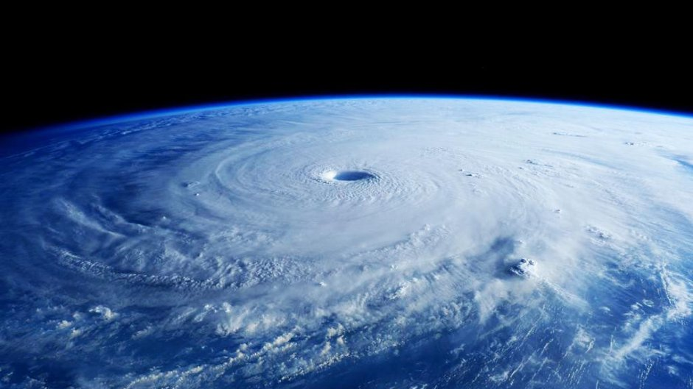
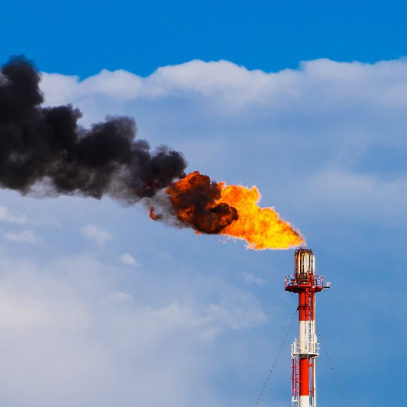
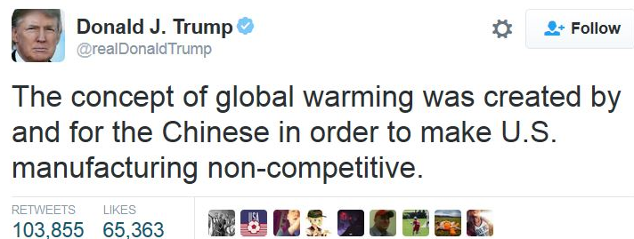
THE STUDY
Discussions around climate change have become increasingly frequent and urgent across the globe. While there are groups of people (including politicians) who are sceptical of climate change, a data-driven approach reveals that there is no doubting that we are in an era of global warming.
This dataset has given us an opportunity to apply our learnings from this course to a topic that is very relevant in our lives, and to uncover firsthand the realities of climate change.

Slide 3
QUESTIONS AND HYPOTHESES
HYPOTHESES |  | QUESTIONS
Global warming exists |  | What evidence is there for global warming between the years 1850 and 2013?
Overall average temperature analysis may mask any changes at a seasonal level. Perhaps winters are getting colder and summers are getting warmer. |  | Do rates of warming vary by season?
There is a relationship between industrialisation and global warming. Rate of warming varies by country, based on level of industrialisation. |  | Are there differences in rates of warming across development stages? Can we observe any peaks following periods of industrialisation? Is there a lag effect?

Slide 4
THE DATA
SOURCE AND CONTENTS
Sourced from Berkeley Earth Data Page
Selected one of seven available datasetS: GlobalLandTemperaturesByCity.csv :
Date
Average Temperature
City
Country
Latitude*
Longitude*
Average Temperature Uncertainty*
*Excluded from analysis
ANALYSIS PARAMETERS:
Due to incomplete data, temperature records before 1850 was excluded. Analysis has been conducted on data from 1850 – 2013.
Six countries were selected for in-depth analysis. These countries were chosen for their relevance in the global warming debate, varied levels of industrialisation, and greater access to qualitative insights.
Country selection was also limited to Northern Hemisphere to simplify seasonal analysis.

Slide 5






SIX COUNTRIES WERE SELECTED FOR ANALYSIS
UNITED STATES OF AMERICA | CHINA | INDIA
North America Industrialised early 1800s 14.34% of CO2 emissions 2016 | Asia Industrialised ~1970s 29.51% of CO2 emissions 2016 | Asia Early 1900s 6.81% of CO2 emissions 2016
SPAIN | NIGERIA | VENEZUELA
Europe Industrialised early 1900s 0.73% of CO2 emissions 2016 | Africa Currently industrialising 0.24% of CO2 emissions 2016 | South America Industrialisation ~1970s 0.50% of CO2 emissions 2016

Slide 7
AVERAGE TEMPERATURES 1850 - 2013
Placeholder for Allison’s graphs
Need to have data for every ten years only and apply a trend line
Maybe also a box plot for 10 year ranges so we can see the spread of temperatures for each country

Slide 8
RATE OF CHANGE SINCE 1850
Placeholder for David’s graphs

Slide 9
EXPLORING SEASONALITY
Placeholder for Christian’s graphs

Slide 10
KEY INSIGHTS

Slide 11
FURTHER QUESTIONS AND HYPOTHESES
How do these relationships and trends apply in the Southern Hemisphere?
Xx
xx

Slide 12
FIN

